Slide 1



PITHAPUR RAJAH'S GOVERMENT DEGREE COLLEGE
DEPARTMENT OF MICROBIOLOGY
LECTURER IN MICROBIOLOGY
Dr Ch Sudhakar

Slide 2

TITLE : IMMUNOLOGY AND MEDICAL MICROBIOLOGY

Slide 3
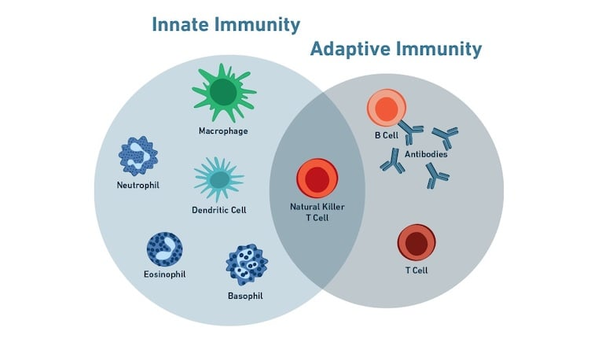
Unit 1: Immune System
Innate and Adaptive Immunity
1. Innate immunity – Non-specific, present from birth
2. Adaptive immunity – Specific, develops after exposure
3. Innate includes barriers, phagocytes, inflammation
4. Adaptive includes B & T cells, antibodies, memory
5. Innate is fast; adaptive is long-lasting

Slide 4
Primary Lymphoid Organs
1. Bone marrow – B cell development
2. Thymus – T cell maturation
3. Bursa of Fabricius – In birds only
4. Role: Production and maturation of immune cells
5. Crucial for adaptive immunity development

Slide 5
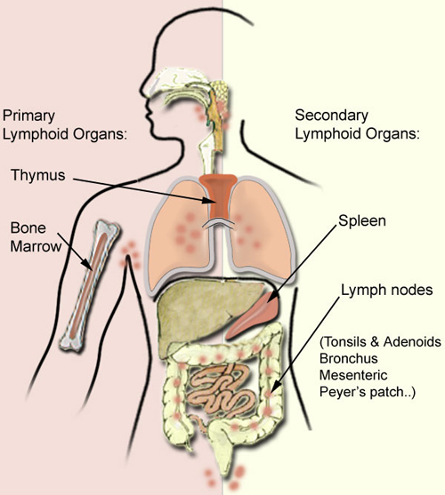
Secondary Lymphoid Organs
1. Spleen – Filters blood
2. Lymph nodes – Trap antigens from lymph
3. MALT/GALT – Mucosal immune defense
4. Role in initiating immune responses
5. Site of antigen-lymphocyte interaction

Slide 6
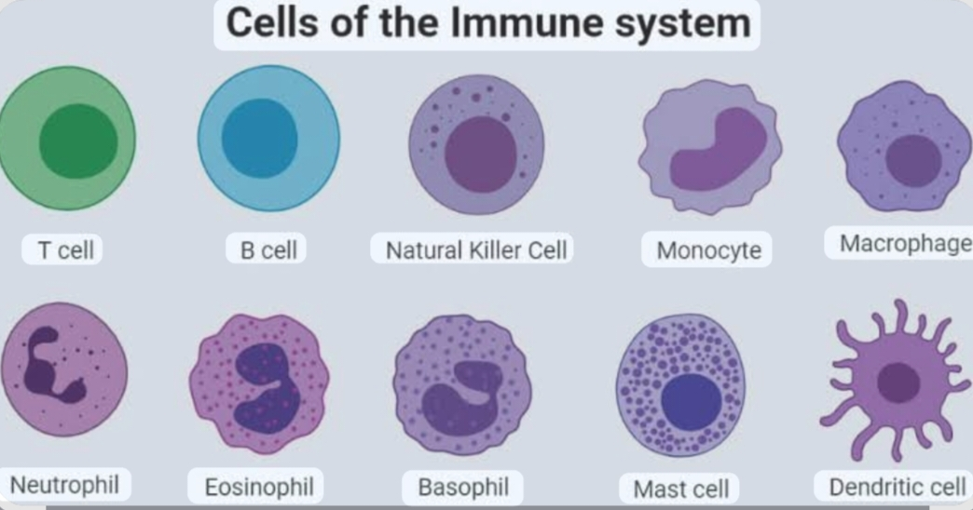
Cells of Immune System
1. B lymphocytes – Antibody production
2. T lymphocytes – Helper & cytotoxic roles
3. Null cells – NK cells, cytotoxic to tumors
4. Monocytes/macrophages – Phagocytosis
5. Neutrophils, basophils, eosinophils – Innate defense

Slide 7
Components of Innate Immunity
1. Physical barriers – Skin, mucosa
2. Chemical barriers – Enzymes, pH
3. Cellular – Phagocytes, NK cells
4. Inflammatory response
5. Complement system (briefly) – Enhances phagocytosis

Slide 8
Unit 2: Immune Response
Antigen Characteristics
1. Foreignness – Non-self molecules
2. Size – Larger molecules are more antigenic
3. Heterogeneity – Complex structures more effective
4. Solubility – Affects immune response
5. Haptens – Small molecules, immunogenic with carrier

Slide 9
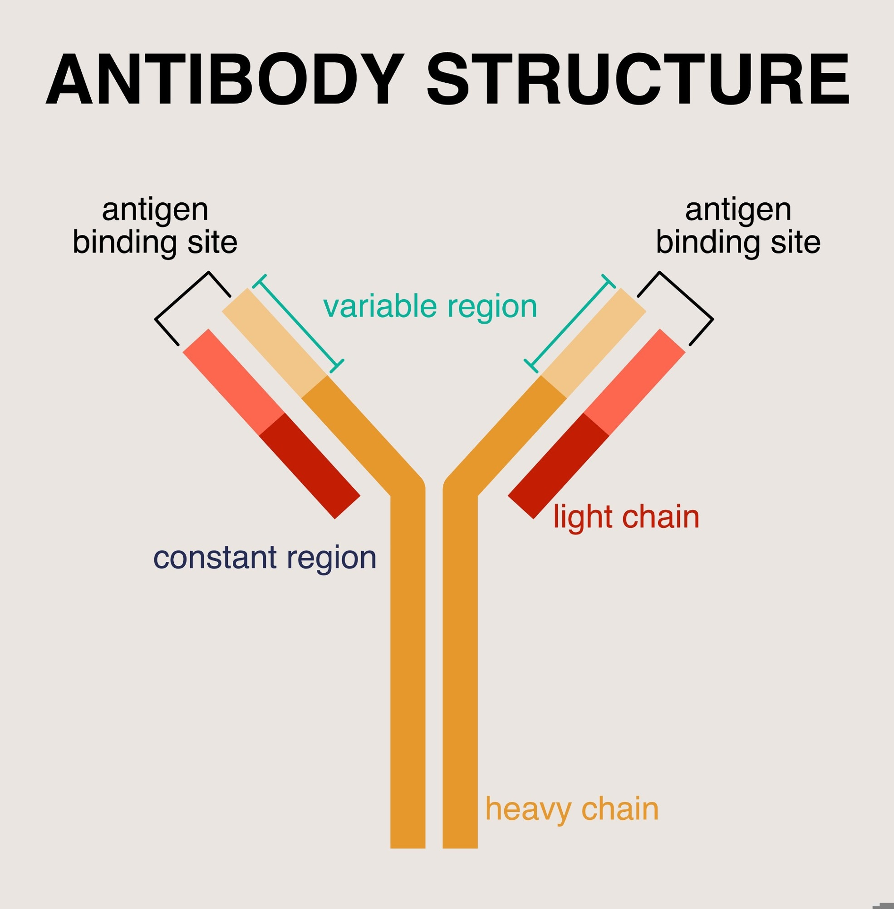
Antibody Structure & Types
1. Y-shaped proteins made of 4 chains
2. Variable region binds antigen
3. IgG – Most abundant
4. IgA – Mucosal immunity
5. IgE – Allergy, IgM – First responder, IgD – B cell receptor

Slide 10
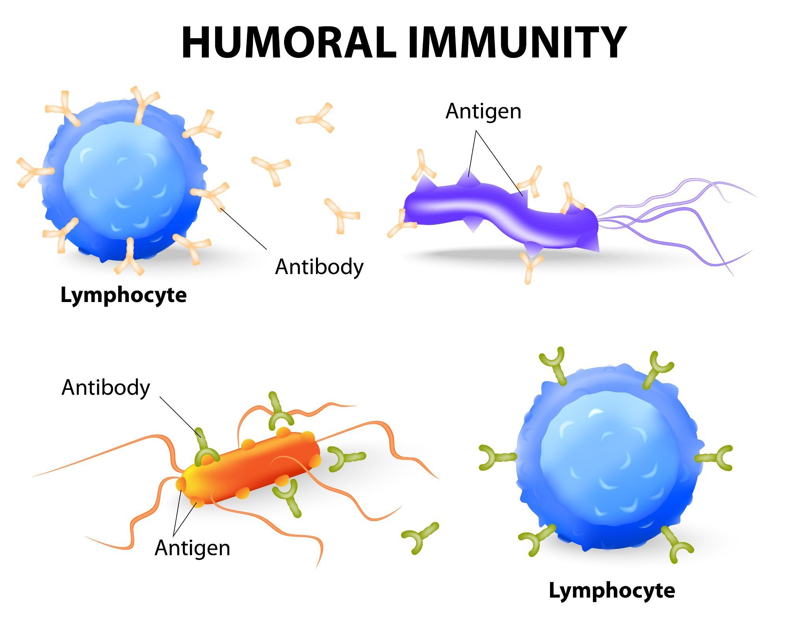
Humoral Immune Response
1. Primary response – Slow, first exposure
2. Secondary response – Fast, memory cells
3. Plasma cells – Produce antibodies
4. Memory B cells – Long-term immunity
5. Major Histocompatibility Complex (MHC) – Antigen presentation

Slide 11
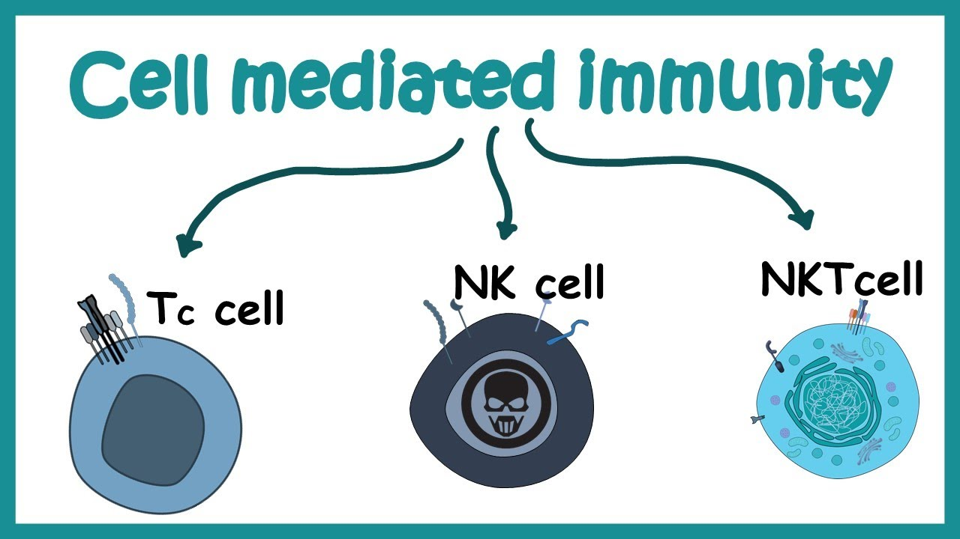
Cell Mediated Immunity & Immune Complex
1. T cells kill infected cells
2. Helper T cells activate B/T cells
3. Agglutination – Clumping of antigens
4. Precipitation – Soluble antigens
5. Neutralization, Complement fixation, Phagocytosis

Slide 12
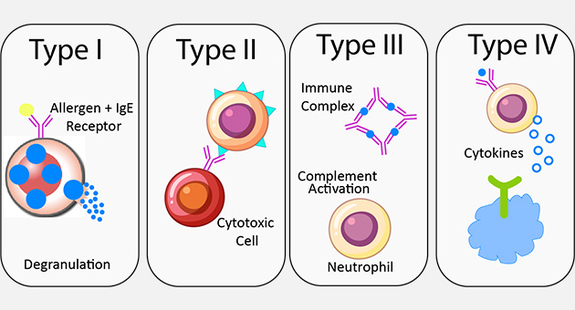
Hypersensitivity
1. Type I – Allergy (IgE)
2. Type II – Cytotoxic (e.g., transfusion reaction)
3. Type III – Immune complex (e.g., lupus)
4. Type IV – Delayed-type (e.g., TB test)
5. Causes overreaction of immune system

Slide 13
Unit 3: Microbes in Health and Disease
Normal Flora of Human Body
1. Present on skin, gut, mouth, etc.
2. Prevents pathogen colonization
3. Produces vitamins (e.g., K)
4. Aids digestion
5. Maintains immunity balance

Slide 14
Key Definitions
1. Infection – Entry and multiplication of microbes
2. Invasion – Spread in host
3. Pathogen – Disease-causing organism
4. Virulence – Degree of pathogenicity
5. Opportunistic & Nosocomial infections

Slide 15
Bacterial & Fungal Diseases
1. Tuberculosis – Mycobacterium tuberculosis
2. Typhoid – Salmonella typhi
3. Botulism – Clostridium botulinum
4. Candidiasis – Candida albicans
5. Brief: symptoms, transmission, prevention

Slide 16
Viral Diseases
1. Hepatitis A – Feco-oral, liver infection
2. AIDS – HIV virus, affects immune system
3. Modes of transmission
4. Diagnosis (ELISA, PCR)
5. Prevention and control basics

Slide 17
Unit 4: Principles of Diagnosis
Sample Collection & Transport
1. Aseptic techniques
2. Proper labeling
3. Use of transport media
4. Time-sensitive transport
5. Prevent contamination

Slide 18
Identification by Culture
1. Use of selective media
2. Solid vs. liquid media
3. Colony morphology observation
4. Gram staining
5. Pure culture isolation

Slide 19
Biochemical & Physiological Tests
1. Catalase, Oxidase tests
2. Sugar fermentation
3. Indole, MR, VP tests
4. Urease, Citrate tests
5. Identification based on metabolic traits

Slide 20
Molecular and Serological Tests
1. PCR – DNA amplification
2. DNA probes – Target-specific hybridization
3. ELISA – Antigen-antibody detection
4. Immunofluorescence – Fluorescent labeling
5. Agglutination & Complement fixation

Slide 21
Unit 5: Prevention and Treatment
Vaccines
1. Active immunity – Natural or recombinant
2. Passive immunity – Ready-made antibodies
3. Examples – MMR, Hepatitis vaccine
4. Herd immunity
5. Importance in disease prevention

Slide 22
Antibacterial Agents
1. Penicillin – Inhibits cell wall synthesis
2. Streptomycin – Inhibits protein synthesis
3. Broad vs. narrow-spectrum
4. Side effects
5. Resistance issues

Slide 23
Antifungal Agents
1. Amphotericin – Binds fungal membranes
2. Griseofulvin – Disrupts mitosis
3. Used for systemic and superficial infections
4. Admin routes: oral, topical
5. Fungal resistance concerns

Slide 24
Antiviral Agents & Interferons
1. Amantadine – For influenza A
2. Acyclovir – For herpes viruses
3. Interferons – Host proteins, antiviral activity
4. Boost immune response
5. Used in cancer/immunotherapy

Slide 25
Antibiotic Resistance & Susceptibility Testing
1. Misuse leads to resistance
2. MDR, XDR pathogens
3. Disc diffusion test (Kirby-Bauer)
4. MIC – Minimum inhibitory concentration
5. Need for rational antibiotic use

Slide 26
THANK YOU

